Slide 1
Best London Boroughs to Live
By: Umair Arif
Project: IBM Capstone
Date: 25th December 2020

Slide 2
Introduction
Approached by a magazine
Quality of Life
Similarity between boroughs
Most popular venues in each borough
Using Python
Webscrapping
Data Visualization

Slide 3
Data Extraction
Quality of life data using pandas
Geographical data from Wikipedia using Beautifulsoup
Data for Venues using Foursquare API

Slide 4
Data Visualization
Using matplotlib to create horizontal bar graphs.
Using Folium to create map of London boroughs.
K-means clustering using sklearn.cluster.

Slide 5
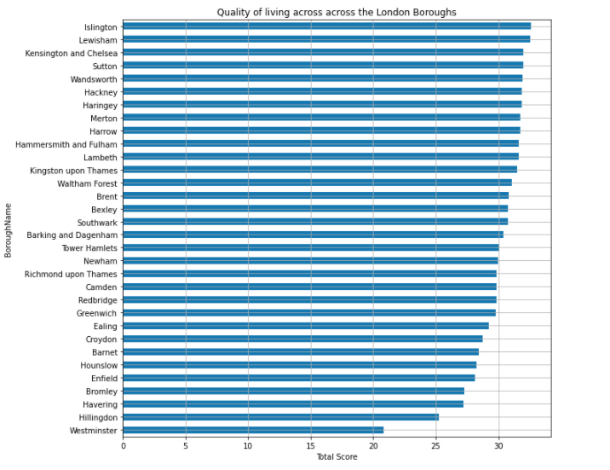
Results Quality of life

Slide 6
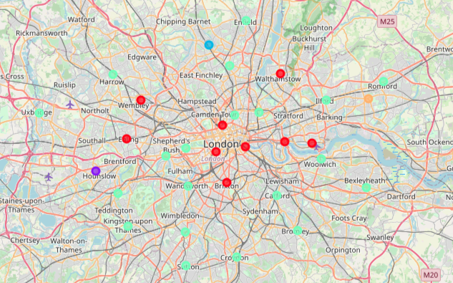
Results: similar boroughs

Slide 7
Results: best venues
Barking and Dagenham for physical activities.
Bexley for shopping and dinning
Barnet for entertainment
Hounslow for dining
Brent most balanced borough

Slide 8
Any Questions?

